Slide 1
Mandated Reporter Flex Training, S2026 VP Avila

Slide 2


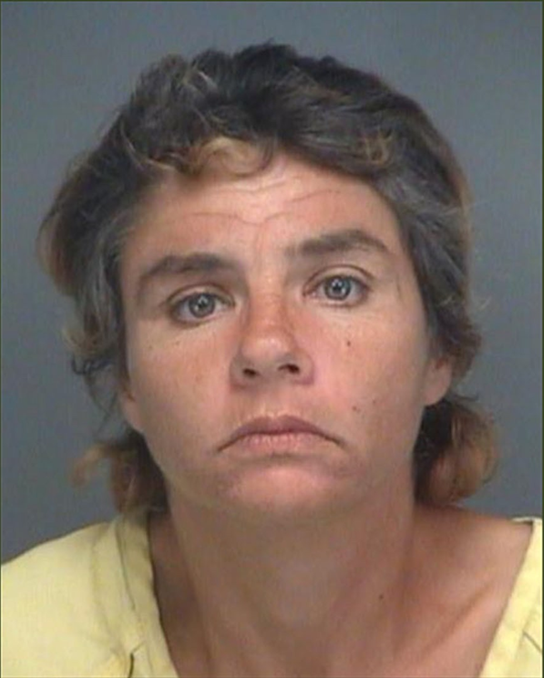
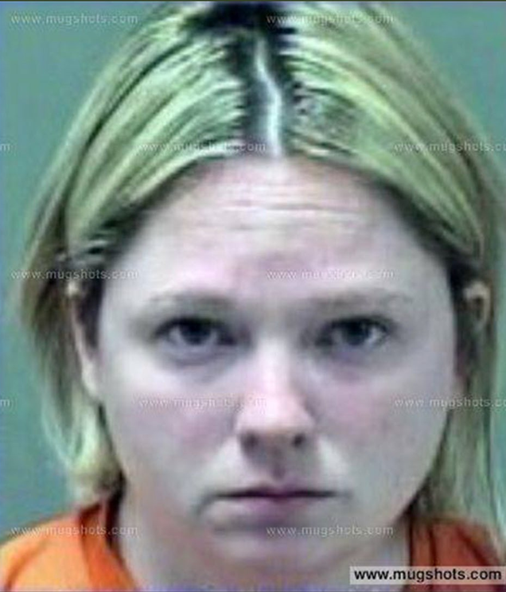
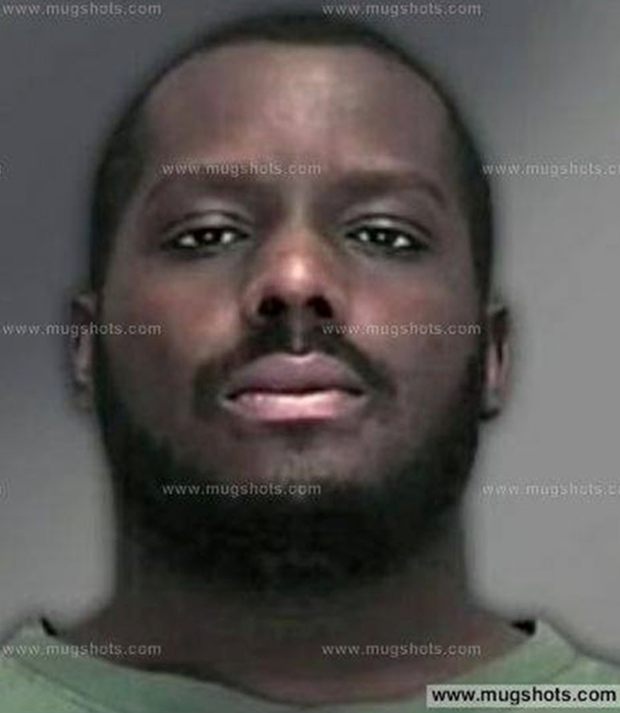
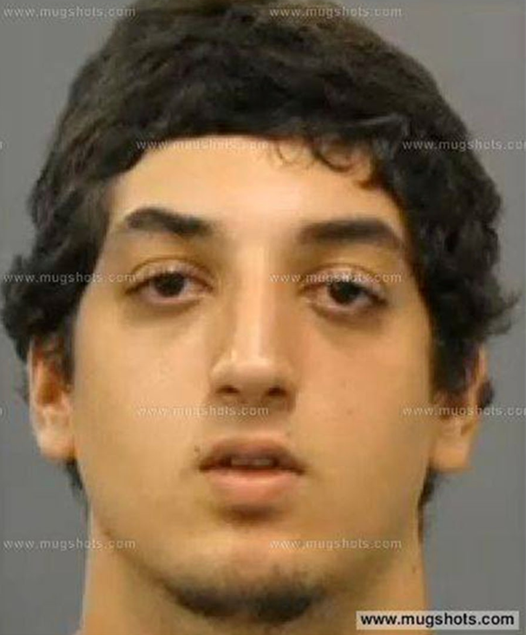

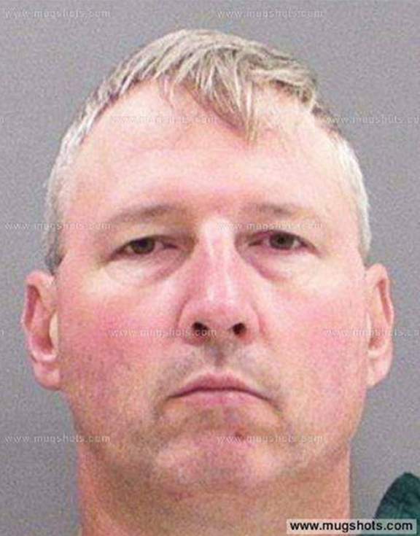
Activity: Who do you supect?

Slide 3


Burglary of a Residence

Slide 4


Preschool Teacher Bit a 13 mo old Child

Slide 5
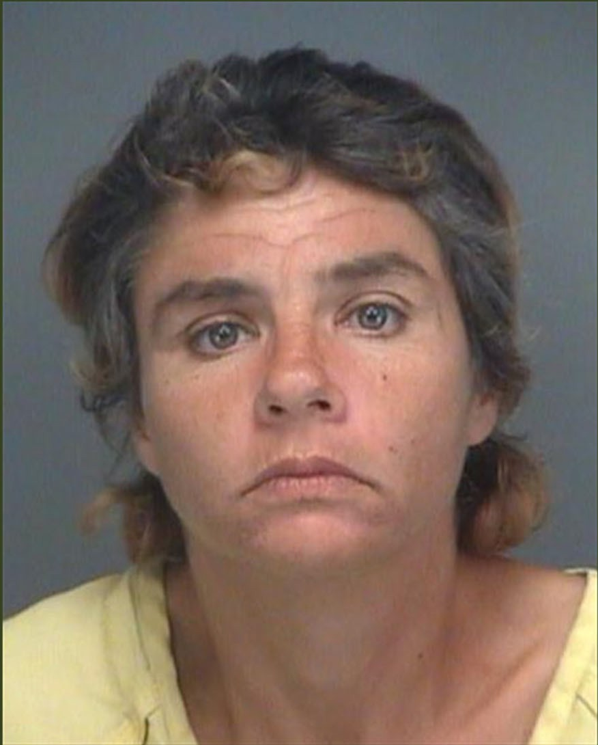

Prostitution

Slide 6
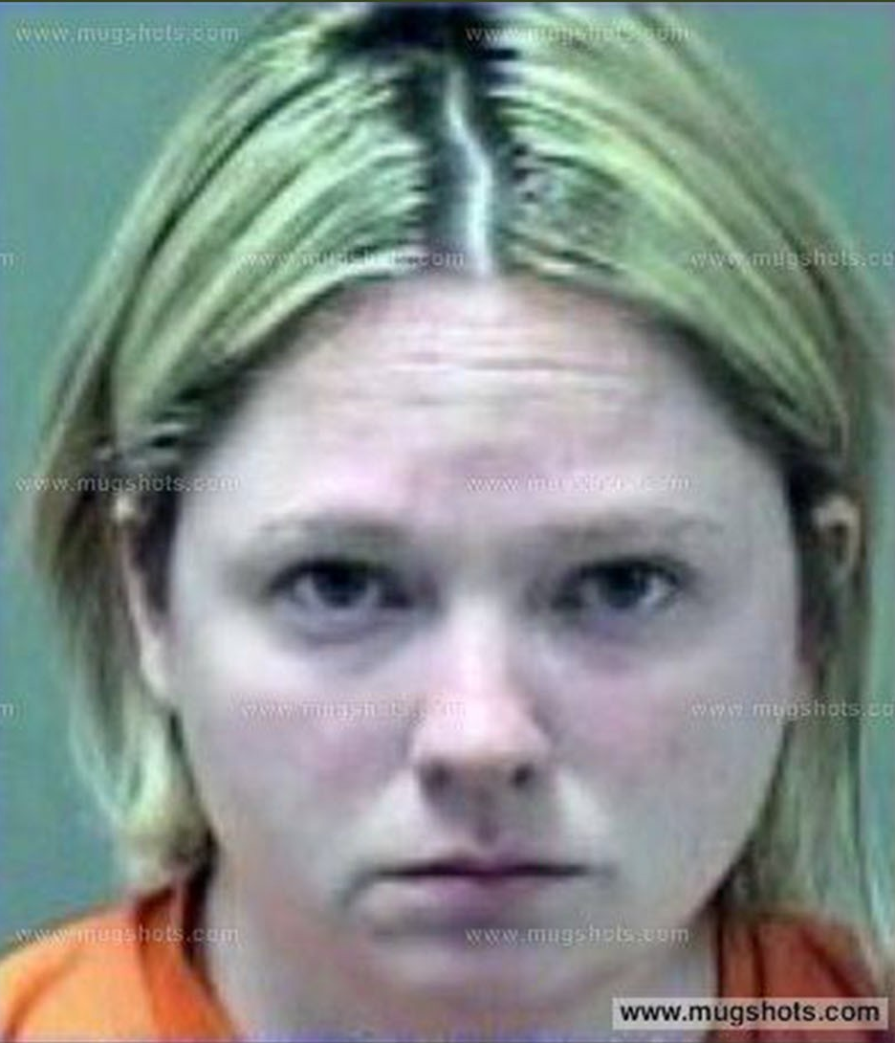

Child Neglect

Slide 7


Sexual Assault on a Child

Slide 8



Drug Rape

Slide 9


Cruelty to Animals

Slide 10




Child Pornography

Slide 11

Your Role: Protecting Our Community
When in Doubt, Report It Out
Your Action Saves Lives
You don't need to be certain—reasonable suspicion is enough. Let the experts investigate.
Timely reporting can be the difference between continued abuse and a person's safety and recovery.
Stay Prepared
Complete your training, know your resources, and keep contact numbers accessible.
Together, we create a safer Merced College community for everyone.

Slide 12
Legal Requirements
Mandated reporter obligations for Merced College employees are established under:
California Penal Code §§ 11164–11174.3 Child Abuse and Neglect Reporting Act (CANRA)
California Welfare & Institutions Code §§ 15630–15634 Elder and Dependent Adult Abuse Reporting
California Education Code § 67383 Community college employee mandated reporter requirements

Slide 13

Ed Code § 67383 (Community Colleges)
Community college districts must designate mandated reporters
Covered employees include:
Faculty (credit and noncredit)
Administrators and managers
Classified professionals
Athletic coaches
Student-facing employees and volunteers
Districts must:
Provide mandated reporter training
Inform employees of their individual legal duty to report
Important: This applies whether abuse occurs on or off campus.

Slide 14
Duty of Care
You can/must protect those under our care. Reporting is a legal duty, not a personal judgment.
Abuse often goes unreported
Employees are legally required to act
Reporting protects:
Children
Vulnerable adults
You as an employee
The institution
An estimate 24 elder abuse cases go unreported for every 1 known to agencies
6 months in a county jail or by a fine of $1,000, or both
Death or great bodily injury: 1 year in a county jail or by a fine of not more than $5,000, or both

Slide 15




Consequences of Not Reporting
Failure to fulfill your mandated reporter obligations carries serious consequences at multiple levels:
Legal Penalties
Penalties including fines up to $1,000 and possible imprisonment for up to six months for failure to report. Consequences are greater if the unreported abuse results in death or great bodily injury.
Employment Consequences
Merced College may take disciplinary actions including suspension, termination, or other employment consequences.
Safety at Risk
Most critically, delayed intervention allows abuse to continue and potentially escalate, putting vulnerable children at greater risk of harm.

Slide 16

Who Is Protected?
You must report suspected abuse involving:
Children (under 18)
Dependent adults
Elder adults (65+)
Includes students, visitors, family members, or anyone who discloses to you.

Slide 17
Types of Abuse You Must Report
Know the Warning Categories
Physical abuse
Sexual abuse or exploitation
Neglect: clothing, food, shelter, medical attendance, or other remedial care.
Emotional abuse
Willful cruelty or unjust punishment
Key point: You do not need proof — only reasonable suspicion.

Slide 18

What Is “Reasonable Suspicion”?
You Are Not an Investigator
Under Penal Code § 11166(a):
A mandated reporter must report when they have “reasonable suspicion” of child abuse or neglect.
Reasonable suspicion means:
A reasonable person would suspect abuse
Based on training or experience
No investigation or verification is required
Do not attempt to confirm, verify, or investigate.

Slide 19

When and How to Report
01
Report Immediately by Phone
Call Child Welfare Services or local law enforcement as soon as you have reasonable suspicion. Do not delay or investigate yourself.
02
Follow Up in Writing
Submit a written report within 36 hours using California Department of Justice form SS 8572.
Merced County Child Welfare Services
Merced Police Department
Phone: (209) 385-8836
Phone: (209) 385-3104
Contact for urgent situations or when immediate law enforcement response is needed.
Available for immediate reporting and guidance on suspected abuse cases.

Slide 20
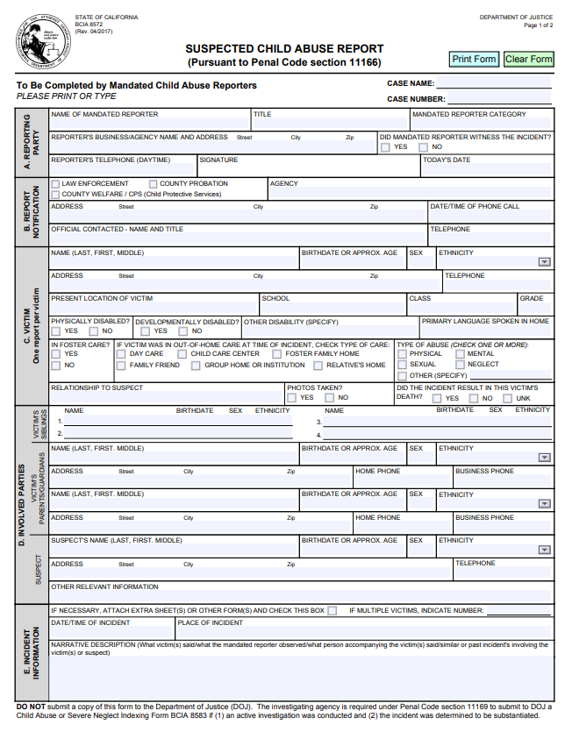
How to Make a Report
1. Call the appropriate agency:
Child Protective Services (CPS) or
Local law enforcement
2. Submit the required written report form.
3. Follow all agency instructions.
Important: Reporting to a supervisor does not satisfy your legal duty.

Slide 21
What Merced College Can and Cannot Do
✔ Supports you after a report
✔ Provides training and guidance
✔ Maintains confidentiality where possible
X Replace your reporting obligation
X Prevent you from reporting
X Investigate instead of reporting

Slide 22
Confidentiality & Immunity
Legal Protections for Mandated Reporters
Your identity is confidential (with limited exceptions)
You are immune from liability when reporting in good faith
Retaliation for reporting is prohibited

Slide 23
What To Say If Someone Discloses
Do:
Listen calmly
Thank them for telling you
Be supportive and respectful
Do not:
Promise confidentiality
Ask leading questions
Express disbelief or judgment

Slide 24

Questions?

