Slide 1
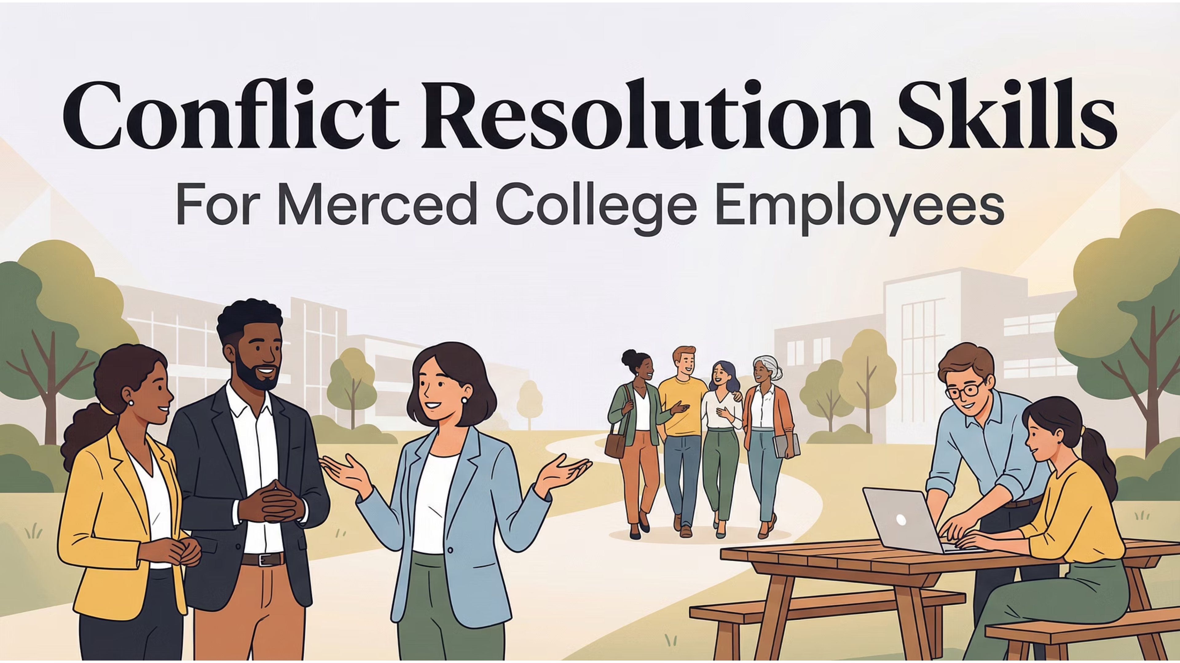

Slide 2
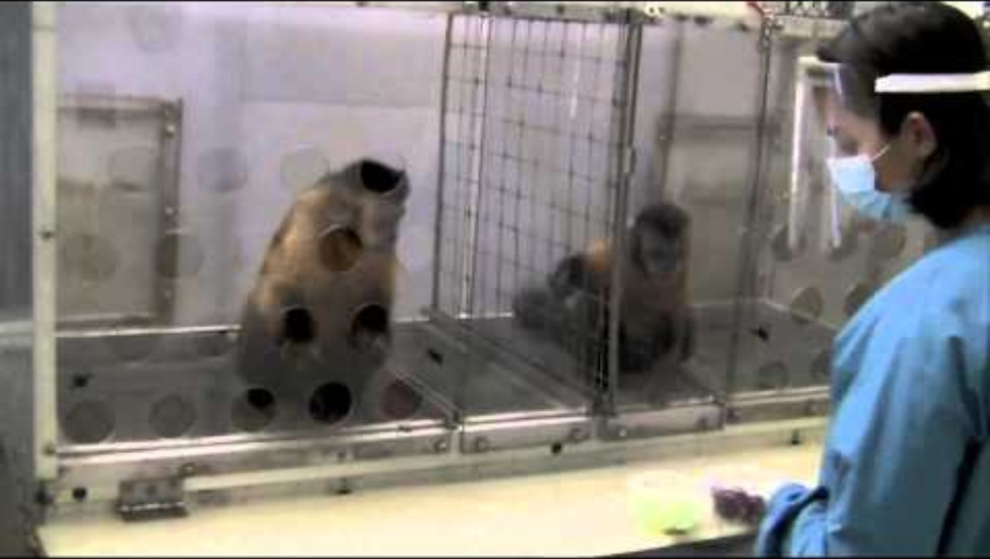

Slide 3
Difficult Conversations
“Conflict is inevitable, but combat is optional.”
- Max Lucade
“Conflict cannot survive without your participation.”
- Wayne Dyer

Slide 4

Be Prepared to Change Your Mind.
If you are afraid of conflict, are you really afraid of being wrong?

Slide 5
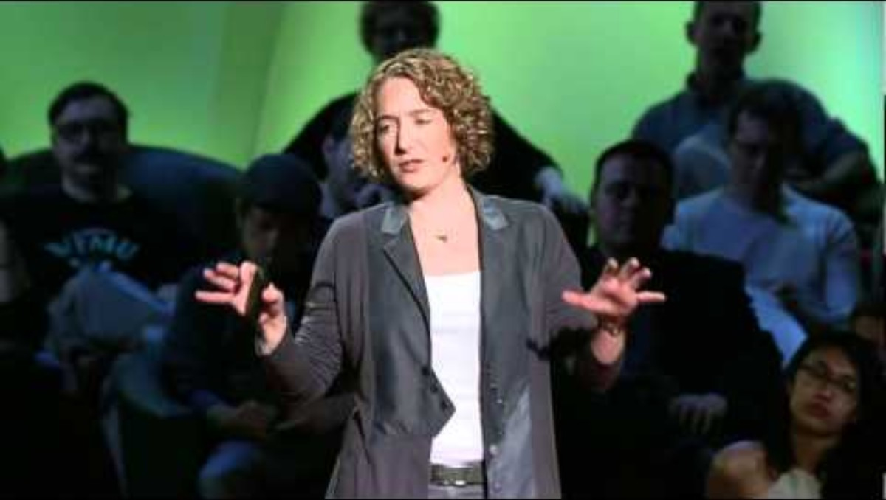
Notes:
Start at 8:05

Slide 6
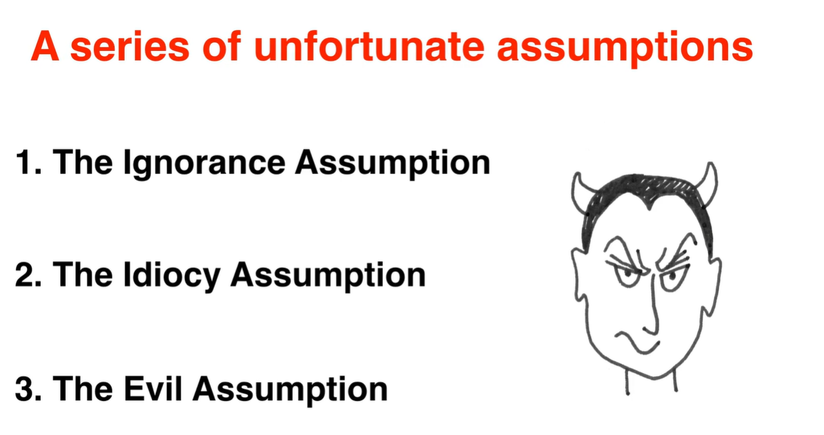

Slide 7
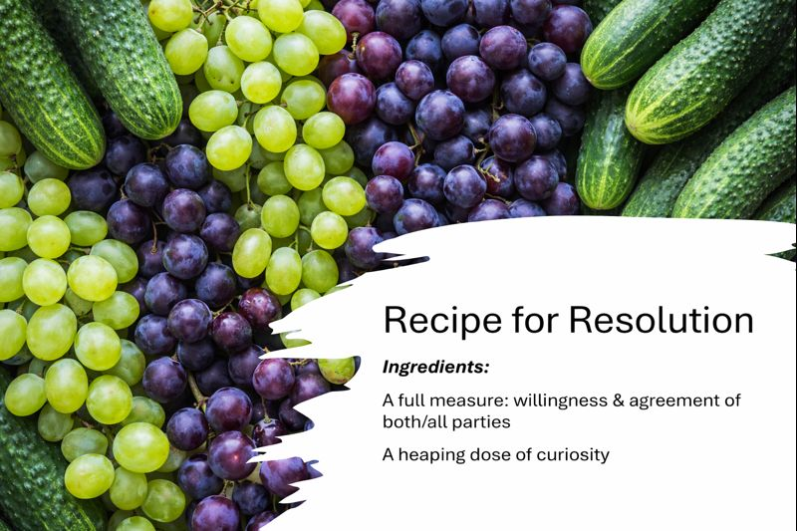

Recipe for Resolution
Ingredients:
A full measure: willingness & agreement of both/all parties
A heaping dose of curiosity

Slide 8
Why have difficult conversations?
inspire action & build trust
Listen, learn, lead
Conflict is an opportunity for change.

Slide 9
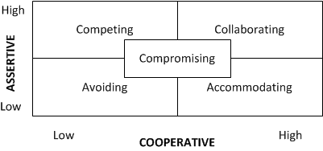
What is your conflict style?

Slide 10
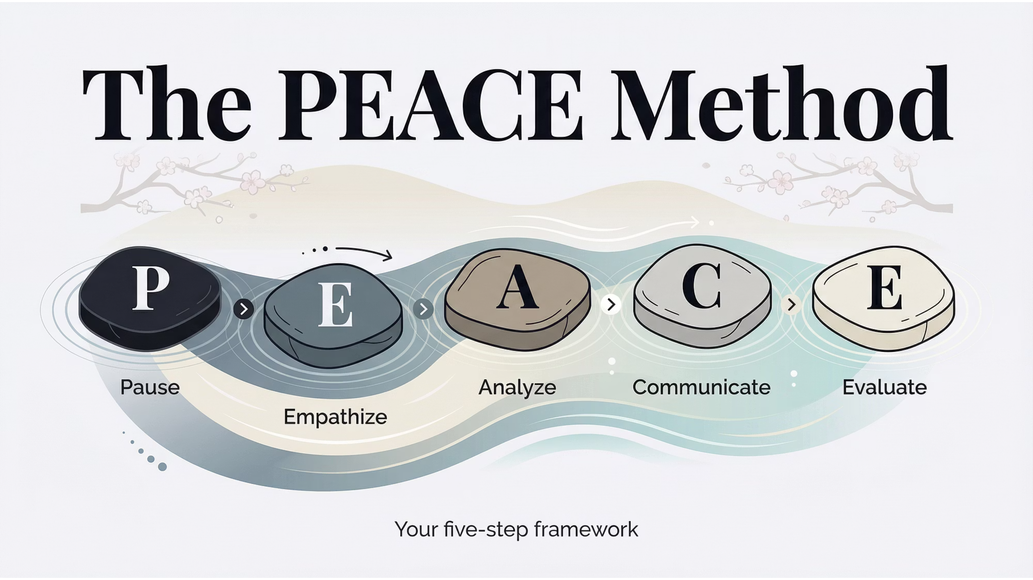
https://educationlab.uchicago.edu/curriculum/conflict-resolution-2/#:~:text=The%20PEACE%20Method:%20*%20P:%20Pause%20&,*%20E:%20Engage%20in%20Commitments%20&%20Closing.

Slide 11
Small Group Instructional Diagnosis (SGID) Modified
Pre-Session Planning
Small-Group Discussion
Consensus and Documentation
Debrief and Action
Facilitation
See also: GRID Method, Avisan Solutions

Slide 12
How to Begin
Don’t procrastinate.
Choose the right place and time.
Sometimes a conversation over coffee is best.
Watch for “power” stance – arrange chairs in circle or next to each other.
Pay attention to body language.
Be authentic and respectful.
Clear is kind.

Slide 13


Slide 14
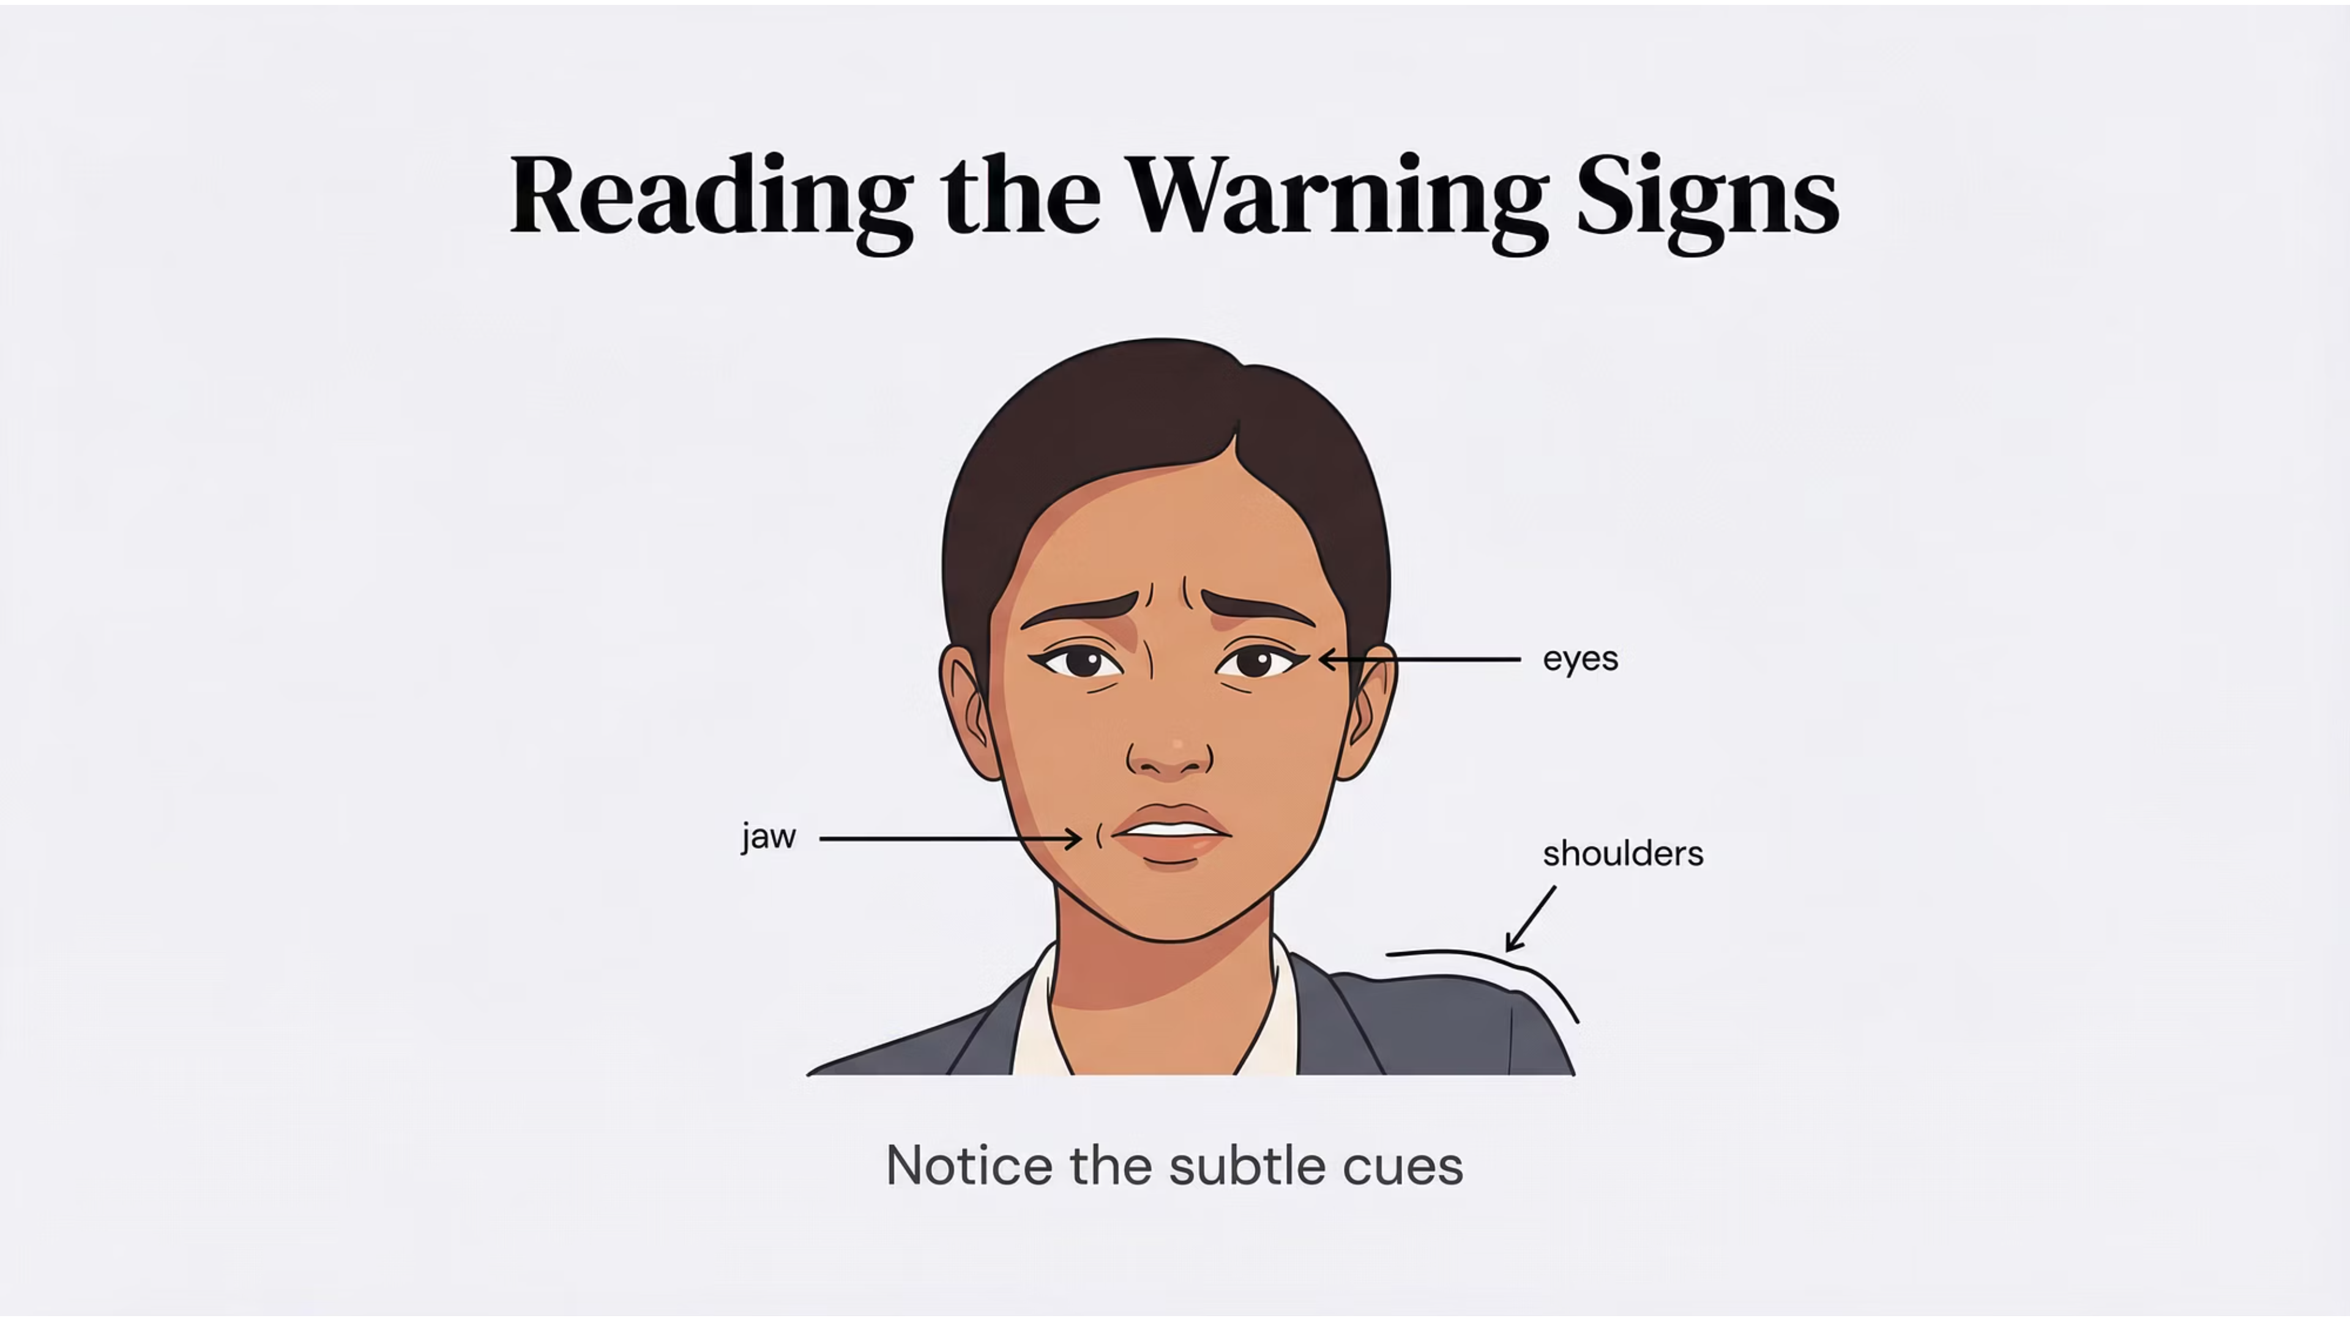

Slide 15
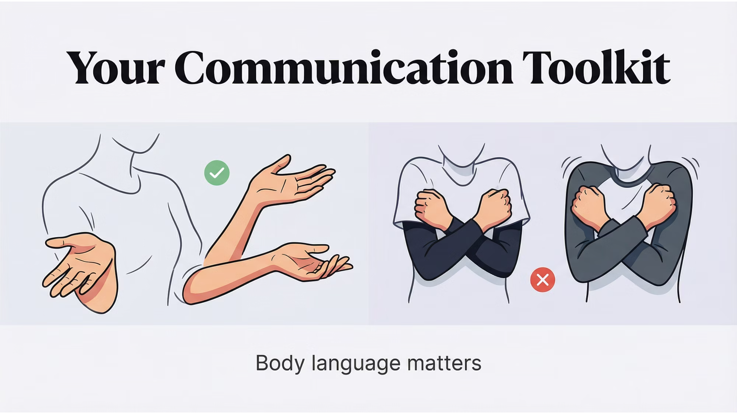

Slide 16

Inquiry, not Inquisition
Shared goal is to understand motivation and resolve the issue.
  If goal is to “win” – stop the process and escalate the matter.
Prompt the parties to tell their side of the story.
Listen, listen, listen.
Socratic questioning will often get you to your goal faster than accusations.
Be comfortable with silence. Leave things unsaid.
  “Is it kind, is it necessary, is it true, does it improve on the silence?”

Slide 17
Guiding Notes:
Those directly involved share their accounts
Each person gets full opportunity to speak
It’s nearly impossible to come to understanding if we don’t give each other the mutual respect of having a space to be heard.
No back-and-forth or responses during this phase
Focus on both facts and feelings
Conflict resolution gets overwhelming when focusing on multiple things at once. Stay on the topic at hand.
Facilitator ensures circle norms are maintained
Use phrases like: “Thank you, [Name]. [Other person], it’s your turn to share your full account.”
If someone tries to respond: “I’ll ask you to hold that thought until it’s your turn.”
Prompt for feelings and solutions: “Can you share more about how this made you feel?” “How do you suggest moving forward?”
Stay with the issue at hand, attacking someone’s character doesn’t move towards resolution.
Nothing is “always” or “never”, this is a thought distortion and will make it more difficult to move forward.

Slide 18
Manage Emotions &
Preserve the Relationship
Separate the issue from the person’s worth.
Don’t withhold a necessary apology or acknowledgment.
Make sure that you are not the problem. Take accountability.
Be consistent and fair.
De-escalate. De-escalate. De-escalate.
De-escalating strategies include pausing, genuinely making an effort to listen, letting the other person speak uninterrupted, not telling the other person that they are “wrong.” You can also take time out by calling for a break or adjourning the meeting.
Disarm the ploy (ex. sarcasm and accusation).
Address the ploy directly

Slide 19
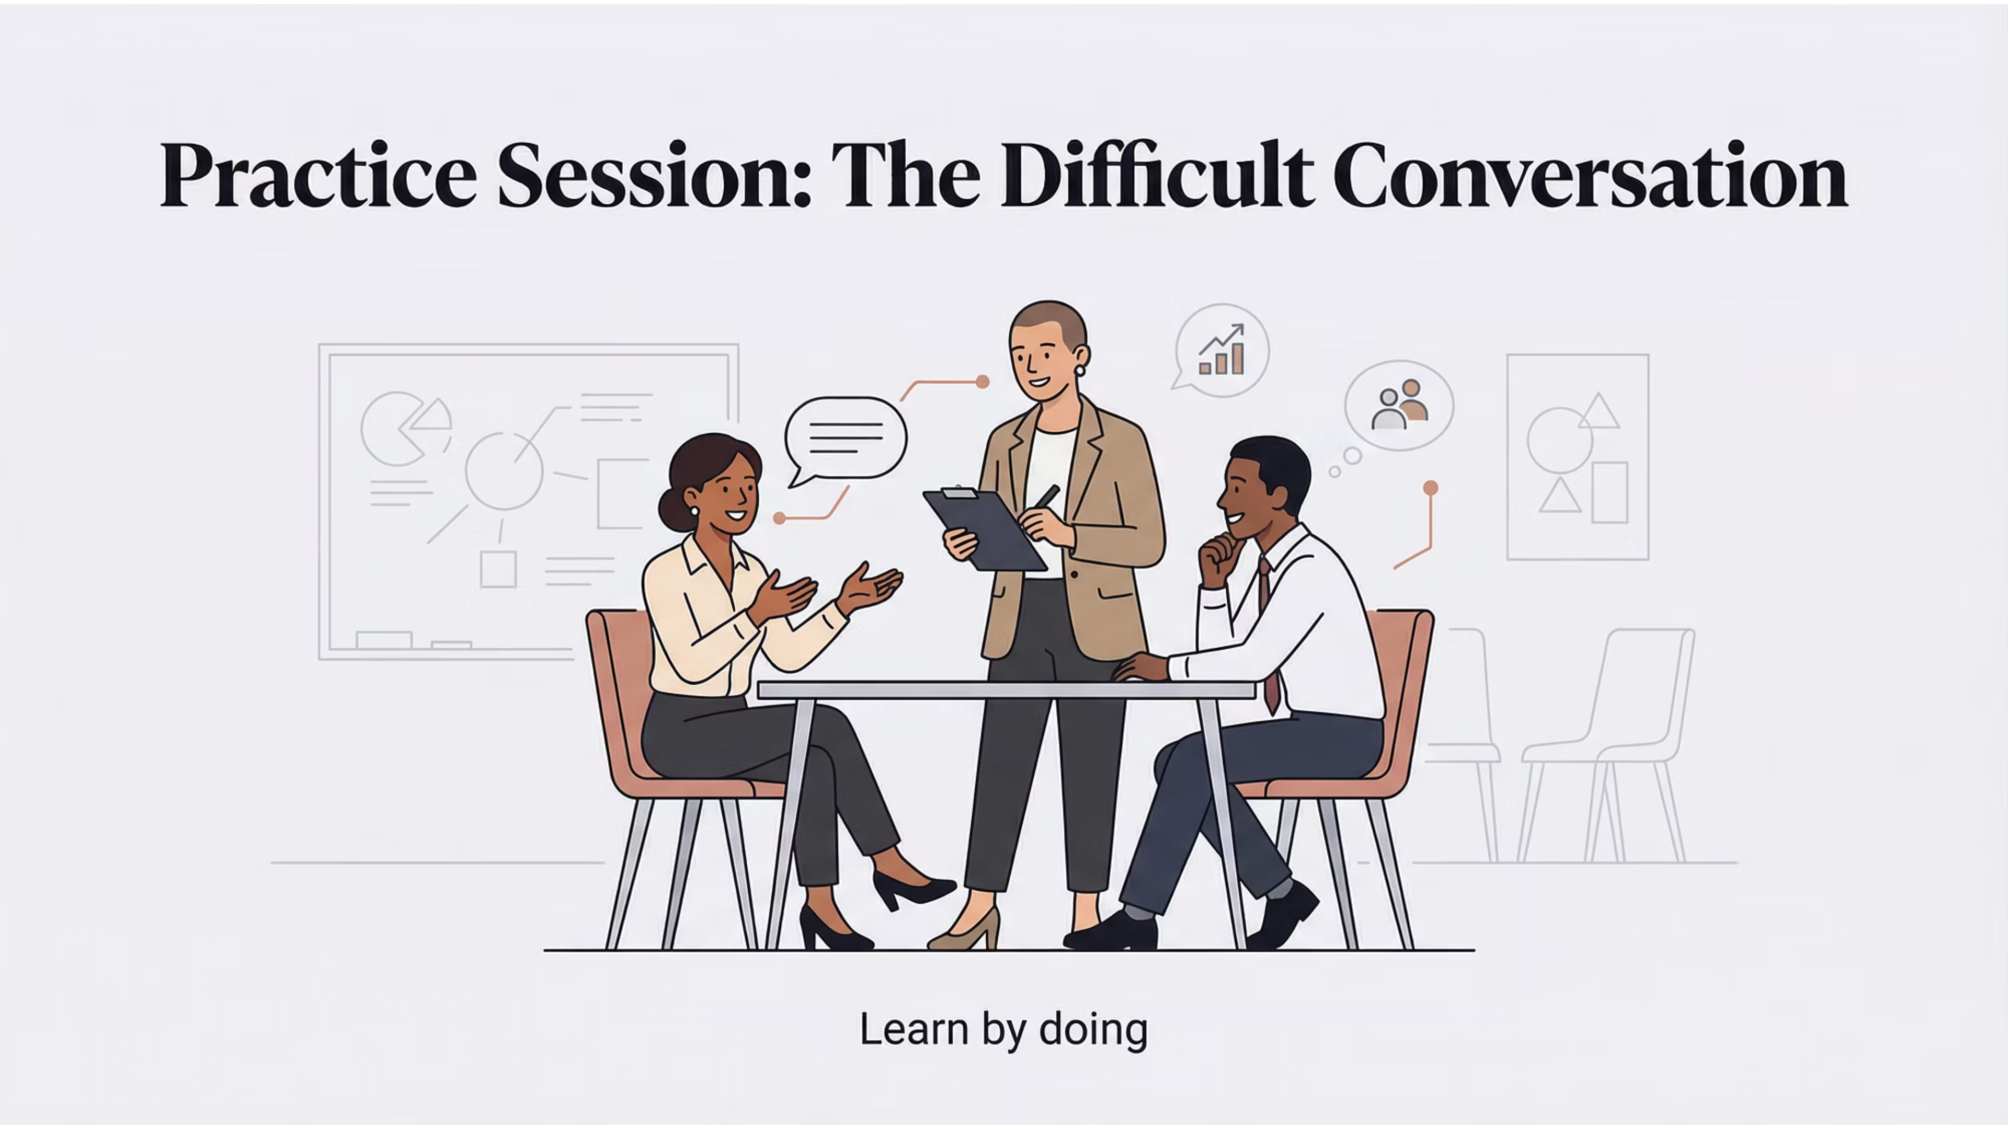
What’s wrong with this image?

Slide 20

How to Finish
Develop action items together throughout the conversation. Reiterate those.
Develop a timeframe to touch base again. You may a second meeting to finish the conversation. Give of your time.
Ask how they are doing. Given them time collect themselves.
Keep it confidential.

Slide 21

HR’s Role in Difficult Conversations
Empower managers and employees to find their own solutions.
Helping without becoming directly involved.
Don’t create relationship of dependency.
  Will undermine the relationship between the manager and the employee.
Sit-in only if absolutely necessary.

Slide 22

Questions?

