Slide 1
Educational Master Plan (EMP) Check-In
Presented by VPSS Michael McCandless

Slide 2
Vivayic
Who They’ve Talked To & Other Important Considerations
Administrators, Faculty/Staff: Interviews and Monthly touch bases, Innovation Challenge
Students: Interviews, Surveys, and In-person Panel (Innovation Challenge)
Community Service Organizations, Leadership, and Employers: Surveys
Data reflects the need for a system-wide approach to the EMP rather than Main Campus and Los Banos.

Slide 3
EMP Development Process
Phase 1: Input
The goal of this phase is to assess the current state and identify trends and issues most likely to affect the ability of Merced College to fulfill its mission and vision.
Where Are We? What are We Working On? What’s Coming?
Collect stories that help form a deep and rich understanding of the perspectives of current, prospective, and former students.
Ongoing: Conduct an analysis of Twitter posts mentioning Merced College for theme generation and identification of ideas and insights.
Plan and conduct surveys of students, alumni, employers, faculty/staff, and community leaders.
Conduct a sensemaking workshop, using all available input, to identify and prioritize the trends, challenges, and opportunities most likely influencing the future of Merced College.

Slide 4
Sensemaking Ground Rules
Consensus-Based Decision Making
In order for this process to be enjoyable, constructive, productive, cooperative, and high-quality, let’s talk through the following agreements:
Listen carefully to what others are saying
Be aware of the purpose, stay on topic
Engage with, build on, and respond to others' ideas/thoughts/perspectives
Express disagreement or concerns constructively and with respect
Be fully present
The goal: When every person can get 80% behind a decision – it doesn’t need to be 100%.
Bus, Ring, Hill - What are you catching the bus for? What are you wed to? What hill are you dying on?

Slide 5
Twitter Analysis
46,169 tweets & retweets scraped from 2007 – 2022.
The Twitter data is then hydrated, leaving 27,073.
Includes tweet and retweet, active and deleted from the full Twitter archive.
We looked for tweets using “Merced College” & “mercedcollege”
Top topics of Merced-related Tweets
31% - Sports
12% - Courses
9% - Registration
6% - Graduation
4% - Current Events

Slide 6
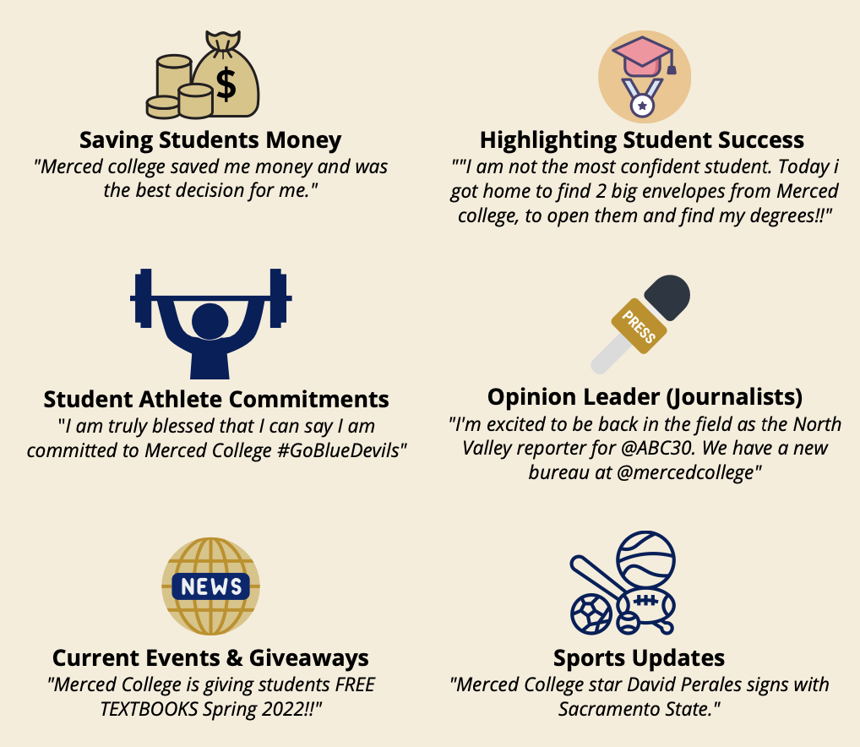
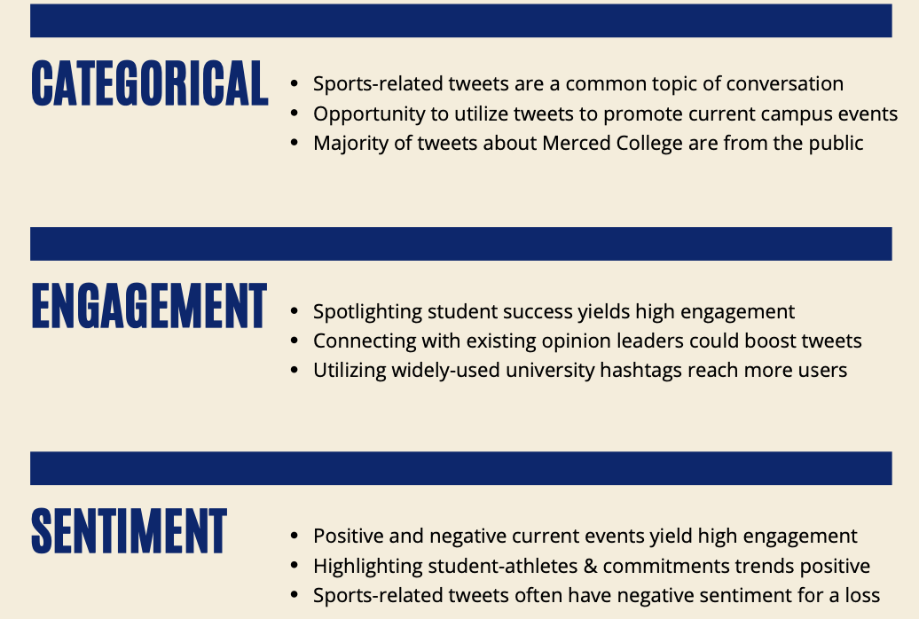
Twitter Analysis
Tweet Engagement
Key Findings

Slide 7
EMP Development Process
Phase 2: Innovation
This phase aims to allow for meaningful consideration of new ideas and perspectives in solving the opportunities and challenges presented in Phase 1 and to lead collective discernment of the strategic imperatives most likely to advance the vision of Merced College.
Key Activities and Outputs:
Plan and conduct a two-day innovation challenge event.
Summarize the event and generate one or more theories of change.
Test theories against Phase 1 input and with workgroup and students.
Summarize feedback and propose strategic imperatives for consideration.
Facilitate the prioritization of strategic imperatives to take to Phase 3 – Testing.

Slide 8
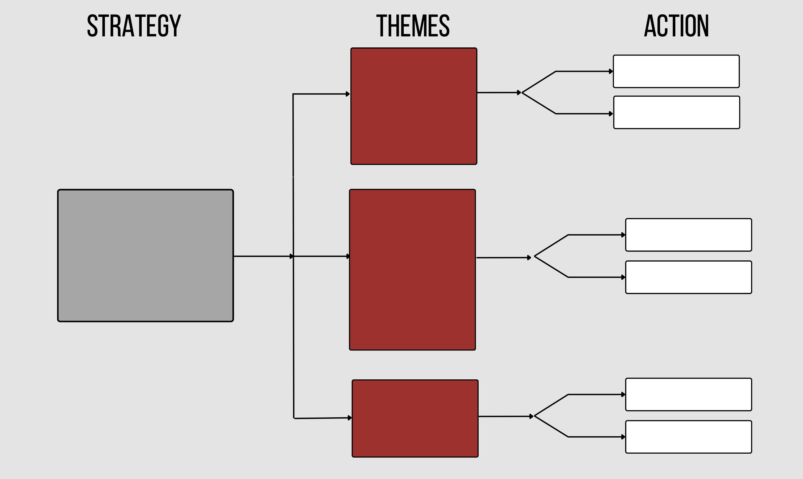
4 Identified Strategic Imperatives

Slide 9
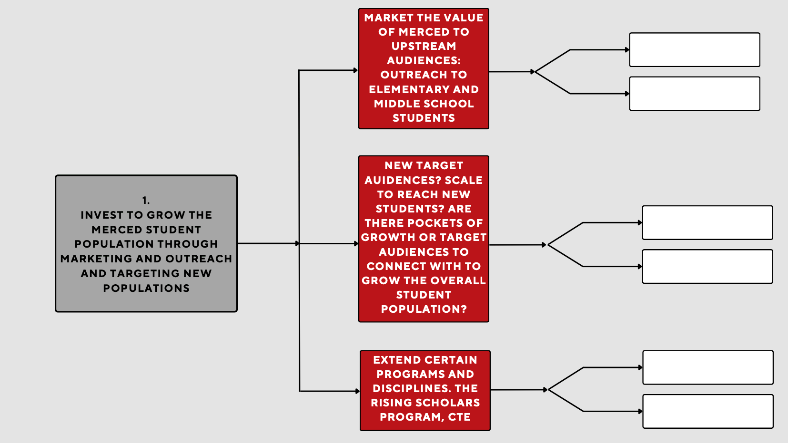

Slide 10
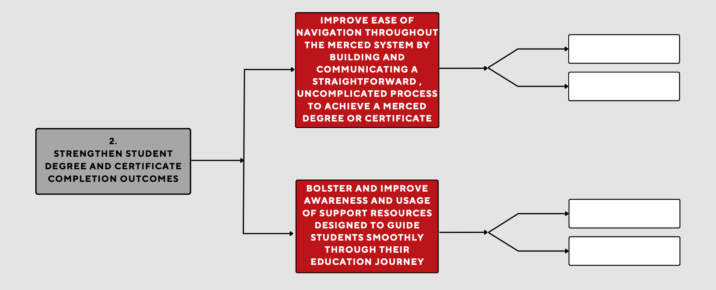

Slide 11
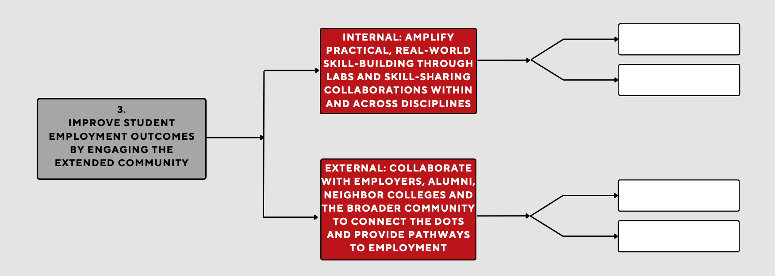

Slide 12
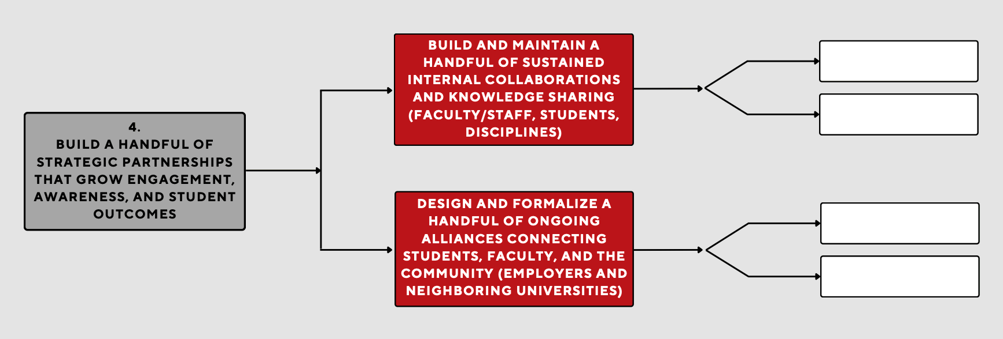

Slide 14
EMP Development Process
Phase 3: Testing
The goal of this phase is to discern both the perceived effectiveness and perceived acceptance of the proposed strategic imperatives identified in Phase 2. Strategic imperatives – especially those that may represent a new perspective or approach – present potential for greater progress toward the college’s vision but can also present a greater risk if feasibility is not fully considered. This phase helps inform the final decision-making by the steering committee in selecting strategic imperatives and related goals to drive the future efforts of the organization.
Key Activities and Outputs:
Identify key considerations for each strategic imperative to evaluate for feasibility
Design, plan, and execute testing methods for the 4 strategic “umbrellas”.
Collect feedback from testing efforts and synthesize findings.
Prepare for and present findings at one or more “town hall” events to identify remaining questions and concerns while assessing the general level of buy-in for the identified imperatives.
Prepare a final report of testing efforts for the task force.

Slide 15
Decision Making Criteria
THE BEST IDEAS…
Amplify real-world applications and strong curriculum | 20%
Reaches as many students as possible | 20%
Longevity, repeatability, scalable, sustainable | 20%
Emphasize what we are best at (i.e. CTE or Nursing Program) | 15%
Have buy-in and commitment from faculty/staff and students | 15%
Has measurable and visible change | 10%

Slide 16
Questions? Comments? Concerns?

