Slide 3
MCCD Website Training

Slide 4
What we’ll cover
Logging in to the new site
Updating/Creating page components
Creating Calendar Events
Updating Contact Cards

Slide 5
Logging in to the new site

Slide 6
https://www.mccd.edu/wp-admin/
Use your Merced College Login
2 ways to get to your page to edit:
Go through the dashboard
Navigate to your page and select edit on the top
Note: edits are restricted to being made on campus.

Slide 7
Best Practices

Slide 8
Cognitive Load
6-7 Items
Remember this when thinking about needing a new page or creating FAQs

Slide 9
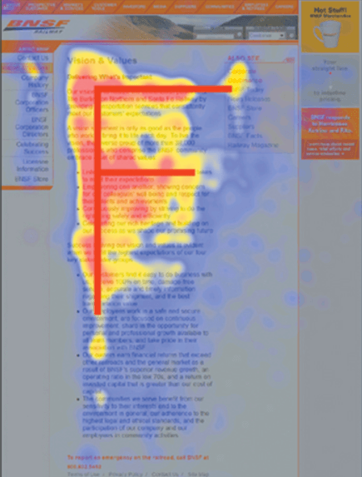
The F-Shaped Pattern

Slide 10
Tone and Voice
Inclusive
Informative
Inviting
Supportive
Active
Clear
Nurturing
Engaging
Guiding
Do your best to remove academic jargon. We need to reach the full spectrum of students and the best way to do that is to write like you are having a conversation with them. Give clear direction and action.

Slide 11
More things…
Use only high quality images. Preferably from our office when possible.
Links must be descriptive (ex. Not click here)
Don’t just post a flyer onto the website. Either convert it to web content on your page or create an event!

Slide 12
Updating Components

Slide 13
General Content
https://www.mccd.edu/fastspot-test-pages/general-content/
https://www.mccd.edu/fastspot-test-pages/general-content-image/

Slide 14
Program Page
https://www.mccd.edu/fastspot-test-pages/example-program-page/

Slide 15
Creating Events

Slide 16
https://www.mccd.edu/wp-admin/edit.php?post_type=tribe_events
Must be Merced College related events
If you feel your event should be featured please contact us

Slide 17
Contact Cards

Slide 18
Things being pulled in from Colleague
Prefix, first name, middle initial, last name, & suffix
Title
Department
Phone number & email
campus

Slide 19
Things we can edit
Location/building
Room number
Office hours
Image
Links to portfolio website/linkedin

Slide 20
Questions?

